Slide 1

Welcome to
OBOMBA
Carter, Maya, Ben

Slide 2
Welcome to
OBOMBA
Carter, Maya, Ben
Different
Displays
Phase 1
Phase 2
Phase 3

Slide 3
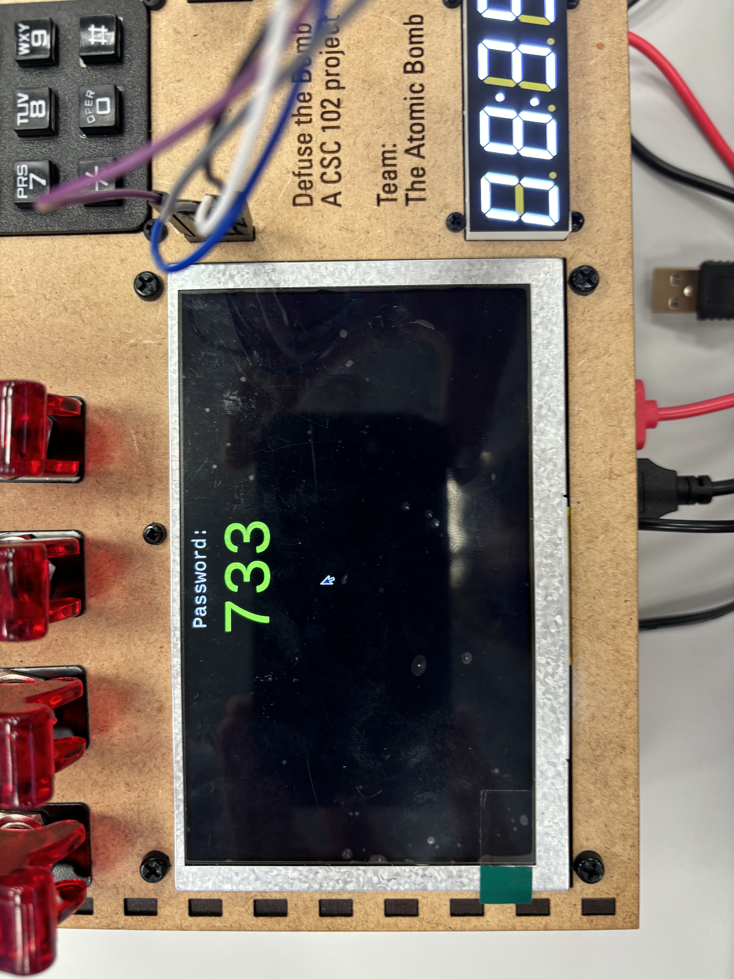
Phase 1
Bombs aren’t just left open
Linked Games
Pound Feature

Slide 4
Phase 2
Wires
Display
Layered
Sensitive
Normal Display
Off-roading from sample
Strikes
Many Tools Function as Usual
Built off of Initial

Slide 5
Phase 3
Button
Display
Color Change
Hold Function
Tap Function
Obama Display
Timer , Diffused and Strikes Transfers
Quit, Exit
Strikes
Riddles
Button Strike
Keypad Strike
Multiple Question
Questions decided on toggle Display

Slide 6
Conclusion
Obomba is special
Displays take new approach
Multilayer
Goals
Make it crazy
Intertwine Phases
Team
Ben-Riddles/Toggles
Maya-Manual/Button
Carter-Wires/Keypad/Display
Updates
New Layers
Crazier displays

